Slide 1
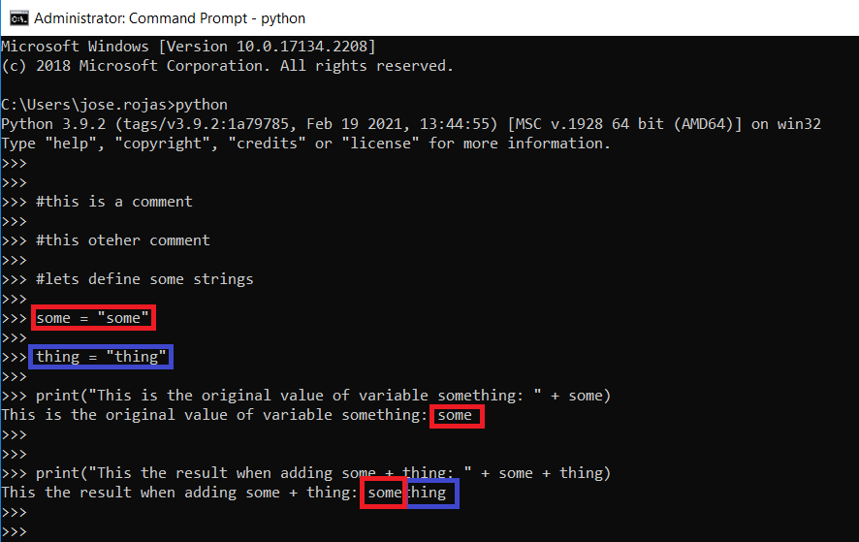
System Manager
Avaya SIP extension creation
Python Script

Slide 2
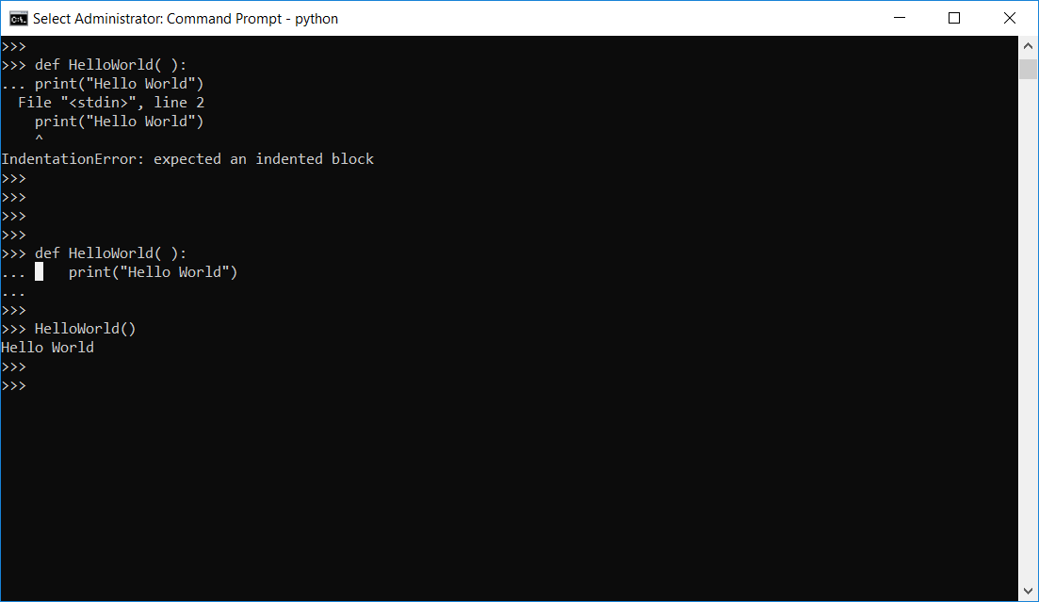
System Manager
Avaya SIP extension creation
Python Script
Python lets you create functions which are parts of code that can be repeated multiple times, only calling the function.
Functions are defined by
def nameOfFunction(arg1, arg2, …):
do something
Any function can have 1 argument, multiple arguments or none.
Its important that the code inside the function must have an indentation of 4 spaces (that lets python understand that code is inside the function).

Slide 3
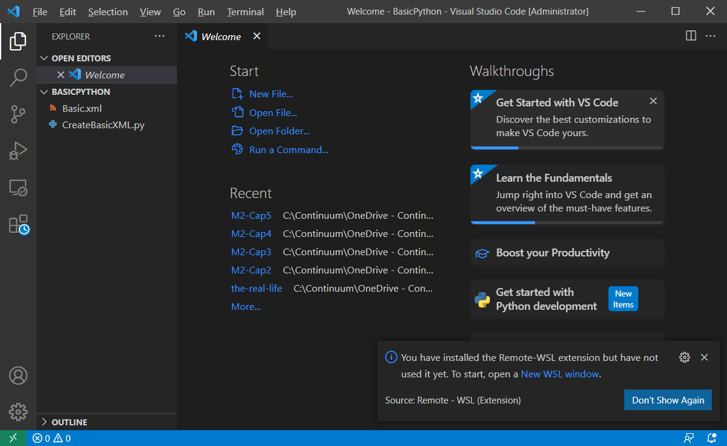
System Manager
Avaya SIP extension creation
Python Script
There are multiple code editors, I like Visual Studio Code.

Slide 4
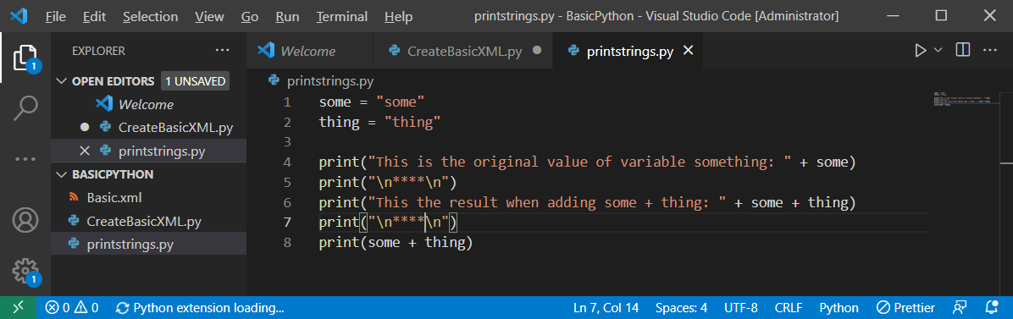
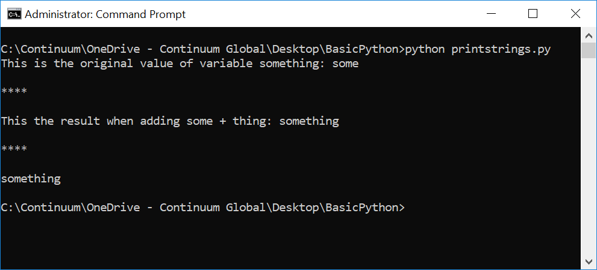
System Manager
Avaya SIP extension creation
Python Script

Slide 5
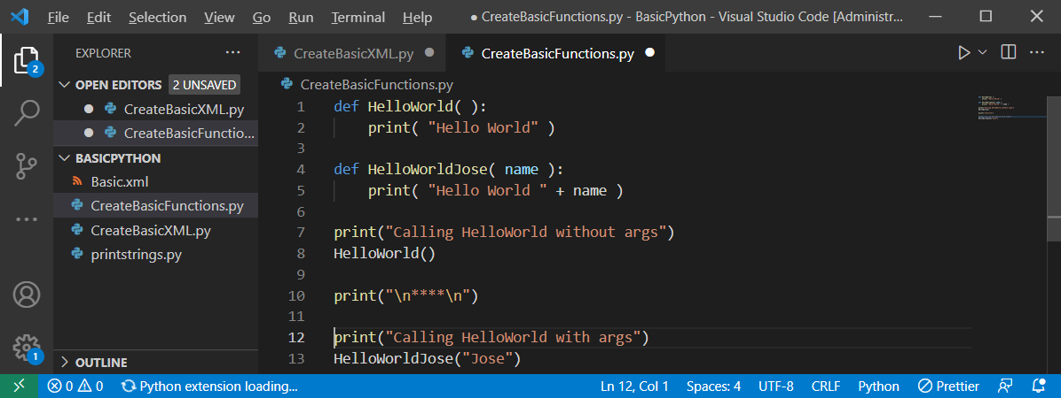
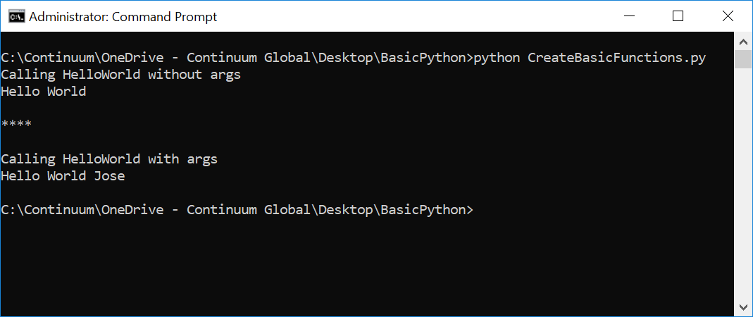
System Manager
Avaya SIP extension creation
Python Script

Slide 6
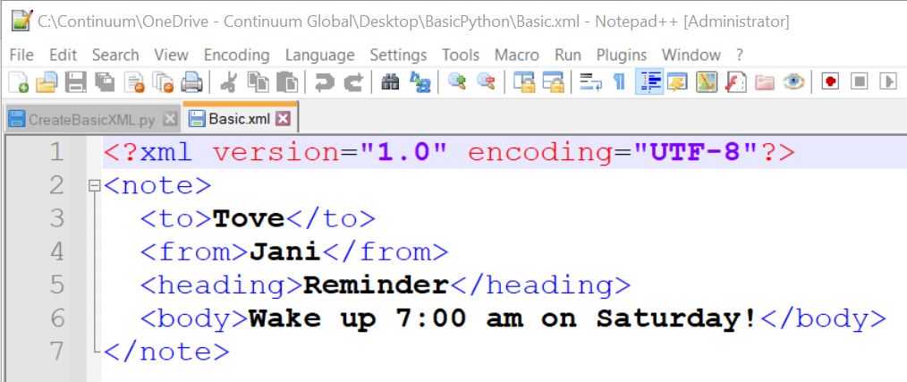
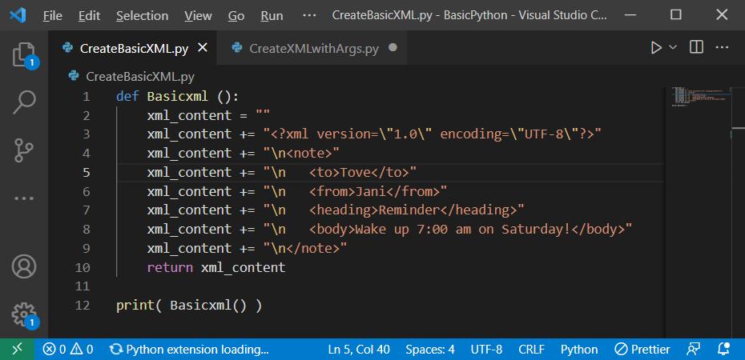
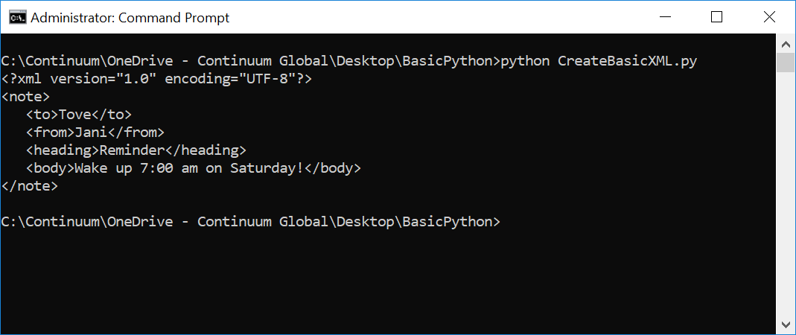
System Manager
Avaya SIP extension creation
Python Script

Slide 7
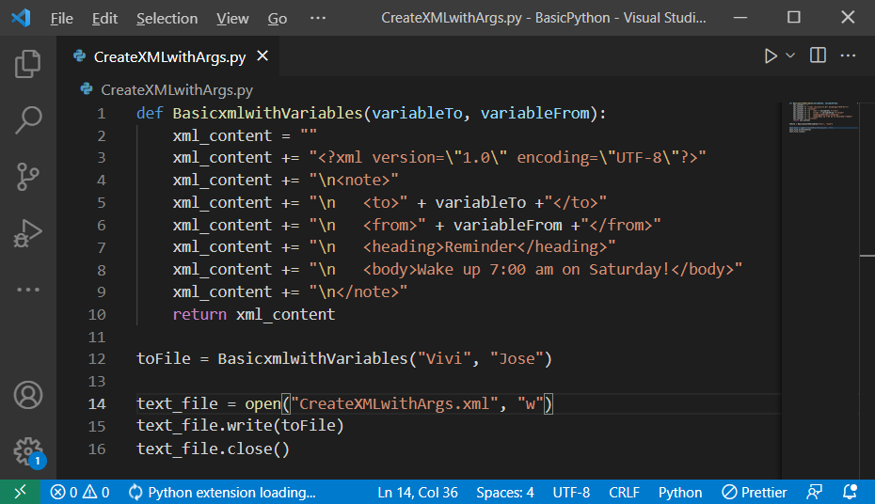
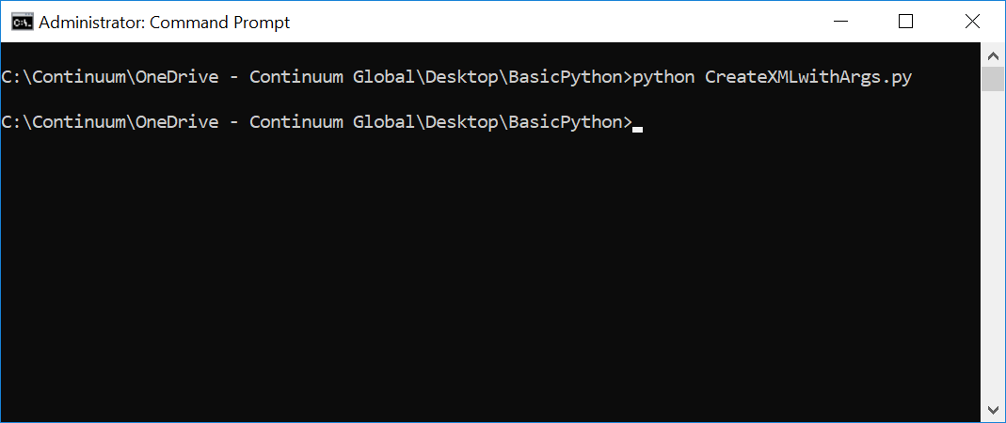
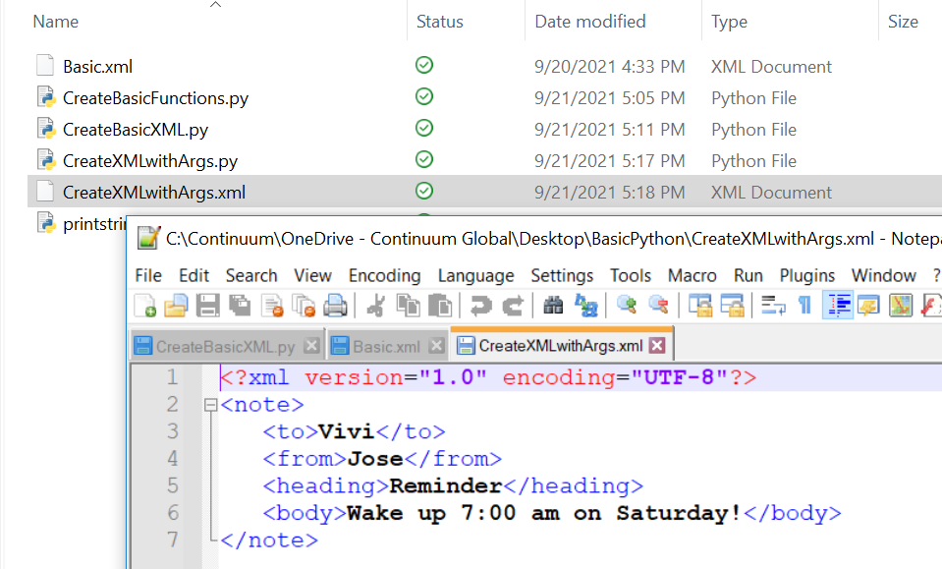
System Manager
Avaya SIP extension creation
Python Script

Slide 8
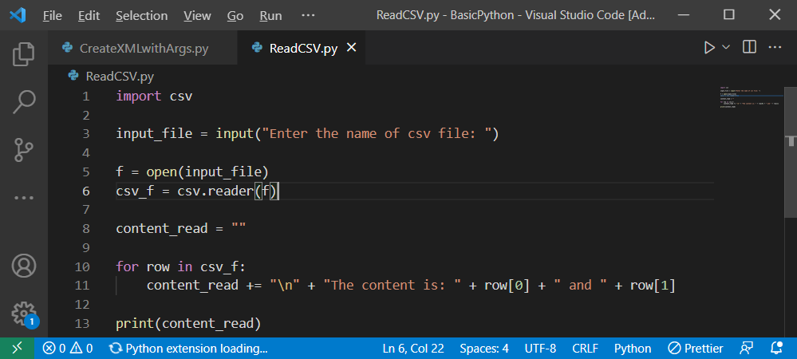
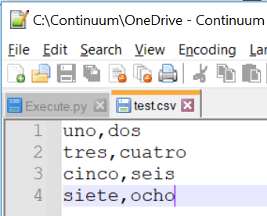
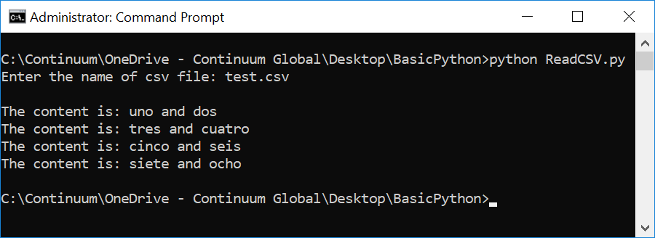
System Manager
Avaya SIP extension creation
Python Script

